Slide 1
NETS 212: Scalable and Cloud Computing
Introduction to Hadoop
October 6, 2015
University of Pennsylvania

Slide 2
Announcements
HW2 will be available shortly
  Single milestone
  Due October 20th at 10:00pm
  Please start early!
    Debugging Hadoop programs can be a bit tricky
    Running something in the cloud on a huge data set is NOT the same thing as running the same program on your laptop with some test data! You MUST ensure that your algorithm scales well and your implementation is efficient!
    You should reserve enough time to attend at least two office hours in case you encounter problems
    Try to finish a few days before the deadline
    Why not start today?
University of Pennsylvania

Slide 3
Goals for today
Goal #1: Be able to write and run simple MapReduce programs on a local Hadoop
  Mappers, reducers, drivers
  Running Hadoop locally
Goal #2: Understand how a distributed Hadoop works internally
  HDFS; internal dataflow; distributed operation
University of Pennsylvania

Slide 4
Plan for today
A brief history of Hadoop
Writing jobs for Hadoop
  Mappers, reducers, drivers
  Compiling and running a job
Hadoop Distributed File System (HDFS)
  Node types; read and write operation
  Accessing data in HDFS
Hadoop internals
  Dataflow: Input format, partitioner, combiner, ...
  Fully distributed mode: Node types, setup
  Fault tolerance; speculative execution
NEXT
University of Pennsylvania

Slide 5


2002-2004: Lucene and Nutch
Early 2000s: Doug Cutting develops
two open-source search projects:
  Lucene: Search indexer
    Used e.g., by Wikipedia
  Nutch: A spider/crawler
  (with Mike Carafella)
Nutch
  Goal: Web-scale, crawler-based search
  Written by a few part-time developers
  Distributed, 'by necessity'
  Demonstrated 100M web pages on 4 nodes, but true
  'web scale' still very distant
University of Pennsylvania

Slide 6
2004-2006: GFS and MapReduce
2003/04: GFS, MapReduce papers published
  Sanjay Ghemawat, Howard Gobioff, Shun-Tak Leung: "The Google File System", SOSP 2003
  Jeffrey Dean and Sanjay Ghemawat: "MapReduce: Simplified Data Processing on Large Clusters", OSDI 2004
  Directly addressed Nutch's scaling issues
GFS & MapReduce added to Nutch
  Two part-time developers over two years (2004-2006)
  Crawler & indexer ported in two weeks
  Ran on 20 nodes
  Much easier to program and run, scales to several 100M web pages, but still far from web scale
University of Pennsylvania

Slide 7
2006-2008: Yahoo
2006: Yahoo hires Cutting
  Provides engineers, clusters, users, ...
  Big boost for the project; Yahoo spends tens of M$
  Not without a price: Yahoo has a slightly different focus (e.g., security) than the rest of the project; delays result
Hadoop project split out of Nutch
  Finally hit web scale in early 2008
Cutting is now at Cloudera
  Startup; started by three top engineers from Google, Facebook, Yahoo, and a former executive from Oracle
  Has its own version of Hadoop; software remains free, but company sells support and consulting services
  Was elected chairman of Apache Software Foundation
University of Pennsylvania

Slide 8
Who uses Hadoop?
Hadoop is running search on some of the Internet's largest sites:
  Amazon Web Services: Elastic MapReduce
  AOL: Variety of uses, e.g., behavioral analysis & targeting
  EBay: Search optimization
  Facebook: Reporting/analytics, machine learning
  Fox Interactive Media: MySpace, Photobucket, Rotten T.
  Last.fm: Track statistics and charts
  IBM: Blue Cloud Computing Clusters
  LinkedIn: People You May Know
  Rackspace: Log processing
  Twitter: Store + process tweets, log files, other data
  Yahoo: >40,000 nodes; biggest cluster is 4,500 nodes/455PB
University of Pennsylvania

Slide 9

Plan for today
A brief history of Hadoop
Writing jobs for Hadoop
  Mappers, reducers, drivers
  Compiling and running a job
Hadoop Distributed File System (HDFS)
  Node types; read and write operation
  Accessing data in HDFS
Hadoop internals
  Dataflow: Input format, partitioner, combiner, ...
  Fully distributed mode: Node types, setup
  Fault tolerance; speculative execution
NEXT
University of Pennsylvania

Slide 10
Simplified scenario
In this section, I will demonstrate how to use Hadoop in standalone mode
  Useful for development and debugging (NOT for production)
  Single node (e.g., your laptop computer)
  No jobtrackers or tasktrackers
  Data in local file system, not in HDFS
This is how the Hadoop installation in your virtual machine works
Later: Fully-distributed mode
  Used when running Hadoop on actual clusters
University of Pennsylvania

Slide 11
Recap: MapReduce dataflow
Intermediate
(key,value) pairs
Mapper
Reducer
Mapper
Reducer
Input data
Output data
Mapper
Reducer
Mapper
Reducer
"The Shuffle"
University of Pennsylvania

Slide 12
What do we need to write?
A mapper
  Accepts (key,value) pairs from the input
  Produces intermediate (key,value) pairs, which are then shuffled
A reducer
  Accepts intermediate (key,value) pairs
  Produces final (key,value) pairs for the output
A driver
  Specifies which inputs to use, where to put the outputs
  Chooses the mapper and the reducer to use
Hadoop takes care of the rest!!
  Default behaviors can be customized by the driver
University of Pennsylvania

Slide 13
Hadoop data types
Name | Description | JDK equivalent
IntWritable | 32-bit integers | Integer
LongWritable | 64-bit integers | Long
DoubleWritable | Floating-point numbers | Double
Text | Strings | String
Hadoop uses its own serialization
  Java serialization is known to be very inefficient
Result: A set of special data types
  All implement the 'Writable' interface
  Most common types shown above; also has some more specialized types (SortedMapWritable, ObjectWritable, ...)
  Caution: Behavior somewhat unusual
University of Pennsylvania

Slide 14
The Mapper
Input format
(file offset, line)
Intermediate format
can be freely chosen
import org.apache.hadoop.mapreduce.*;
import org.apache.hadoop.io.*;
public class FooMapper extends Mapper<LongWritable, Text, Text, Text> {
public void map(LongWritable key, Text value, Context context) {
context.write(new Text("foo"), value);
}
}
Extends abstract 'Mapper' class
  Input/output types are specified as type parameters
Implements a 'map' function
  Accepts (key,value) pair of the specified type
  Writes output pairs by calling 'write' method on context
  Mixing up the types will cause problems at runtime (!)
University of Pennsylvania

Slide 15
The Reducer
Intermediate format
(same as mapper output)
Output format
import org.apache.hadoop.mapreduce.*;
import org.apache.hadoop.io.*;
public class FooReducer extends Reducer<Text, Text, IntWritable, Text> {
public void reduce(Text key, Iterable<Text> values, Context context)
throws java.io.IOException, InterruptedException
{
for (Text value: values)
context.write(new IntWritable(4711), value);
}
}
Note: We may get
multiple values for
the same key!
Extends abstract 'Reducer' class
  Must specify types again (must be compatible with mapper!)
Implements a 'reduce' function
  Values are passed in as an 'Iterable'
  Caution: These are NOT normal Java classes. Do not store them in collections - content can change between iterations!
University of Pennsylvania

Slide 16
The Driver
import org.apache.hadoop.mapreduce.*;
import org.apache.hadoop.io.*;
import org.apache.hadoop.fs.Path;
import org.apache.hadoop.mapreduce.lib.input.FileInputFormat;
import org.apache.hadoop.mapreduce.lib.output.FileOutputFormat;
public class FooDriver {
public static void main(String[] args) throws Exception {
Job job = new Job();
job.setJarByClass(FooDriver.class);
FileInputFormat.addInputPath(job, new Path("in"));
FileOutputFormat.setOutputPath(job, new Path("out"));
job.setMapperClass(FooMapper.class);
job.setReducerClass(FooReducer.class);
job.setOutputKeyClass(Text.class);
job.setOutputValueClass(Text.class);
System.exit(job.waitForCompletion(true) ? 0 : 1);
}
}
Mapper&Reducer are
in the same Jar as
FooDriver
Input and Output
paths
Format of the (key,value)
pairs output by the
reducer
Specifies how the job is to be executed
  Input and output directories; mapper & reducer classes
University of Pennsylvania

Slide 17
Plan for today
A brief history of Hadoop
Writing jobs for Hadoop
  Mappers, reducers, drivers
  Compiling and running a job
Hadoop Distributed File System (HDFS)
  Node types; read and write operation
  Accessing data in HDFS
Hadoop internals
  Dataflow: Input format, partitioner, combiner, ...
  Fully distributed mode: Node types, setup
  Fault tolerance; speculative execution
NEXT
University of Pennsylvania

Slide 18
Manual compilation
Goal: Produce a JAR file that contains the classes for mapper, reducer, and driver
  This can be submitted to the Job Tracker, or run directly through Hadoop
Step #1: Put hadoop-core-1.0.3.jar into classpath:
export CLASSPATH=$CLASSPATH:/path/to/hadoop/hadoop-core-1.0.3.jar
Step #2: Compile mapper, reducer, driver:
javac FooMapper.java FooReducer.java FooDriver.java
Step #3: Package into a JAR file:
jar cvf Foo.jar *.class
Alternative: "Export..."/"Java JAR file" in Eclipse
University of Pennsylvania

Slide 19
Compilation with Ant
<project name="foo" default="jar" basedir="./">
<target name="init">
<mkdir dir="classes"/>
</target>
<target name="compile" depends="init">
<javac srcdir="src" destdir="classes" includes="*.java" debug="true"/>
</target>
<target name="jar" depends="compile">
<jar destfile="foo.jar">
<fileset dir="classes" includes="**/*.class"/>
</jar>
</target>
<target name="clean">
<delete dir="classes"/>
<delete file="foo.jar"/>
</target>
</project>
Makes the JAR
file
Directory where
source files
are kept
Clean up any
derived files
Apache Ant: A build tool for Java (~"make")
  Run "ant jar" to build the JAR automatically
  Run "ant clean" to clean up derived files (like make clean)
University of Pennsylvania

Slide 20
Standalone mode installation
What is standalone mode?
  Installation on a single node
  No daemons running (no Task Tracker, Job Tracker)
  Hadoop runs as an 'ordinary' Java program
  Used for debugging
How to install Hadoop in standalone mode?
  See Textbook Appendix A
  Already done in your VM image
University of Pennsylvania

Slide 21
Running a job in standalone mode
Step #1: Create & populate input directory
  Configured in the Driver via addInputPath()
  Put input file(s) into this directory (ok to have more than 1)
  Output directory must not exist yet
Step #2: Run Hadoop
  As simple as this: hadoop jar <jarName> <driverClassName>
  Example: hadoop jar foo.jar upenn.nets212.FooDriver
  In verbose mode, Hadoop will print statistics while running
Step #3: Collect output files
University of Pennsylvania

Slide 22
Recap: Writing simple jobs for Hadoop
Write a mapper, reducer, driver
  Custom serialization → Must use special data types (Writable)
  Explicitly declare all three (key,value) types
Package into a JAR file
  Must contain class files for mapper, reducer, driver
  Create manually (javac/jar) or automatically (ant)
Running in standalone mode
  hadoop jar foo.jar FooDriver
  Input and output directories in local file system
More details: Chapters 2,5,6 of your textbook
University of Pennsylvania

Slide 23
Wait a second...
Wasn't Hadoop supposed to be very scalable?
  Work on Petabytes of data, run on thousands of machines
Some more puzzle pieces are needed
  Special file system that can a) hold huge amounts of data, and b) feed them into MapReduce efficiently
  → Hadoop Distributed File System (HDFS)
  Framework for distributing map and reduce tasks across many nodes, coordination, fault tolerance...
  → Fully distributed mode
  Mechanism for customizing dataflow for particular applications (e.g., non-textual input format, special sort...)
  → Hadoop data flow
University of Pennsylvania

Slide 24
Plan for today
A brief history of Hadoop
Writing jobs for Hadoop
  Mappers, reducers, drivers
  Compiling and running a job
Hadoop Distributed File System (HDFS)
  Node types; read and write operation
  Accessing data in HDFS
Hadoop internals
  Dataflow: Input format, partitioner, combiner, ...
  Fully distributed mode: Node types, setup
  Fault tolerance; speculative execution
NEXT
University of Pennsylvania

Slide 25
What is HDFS?
HDFS is a distributed file system
  Makes some unique tradeoffs that are good for MapReduce
What HDFS does well:
  Very large read-only or append-only files (individual files may contain Gigabytes/Terabytes of data)
  Sequential access patterns
What HDFS does not do well:
  Storing lots of small files
  Low-latency access
  Multiple writers
  Writing to arbitrary offsets in the file
University of Pennsylvania

Slide 26


HDFS versus NFS
Network File System (NFS)
Hadoop Distributed File System (HDFS)
Single machine makes part of its file system available to other machines
Sequential or random access
PRO: Simplicity, generality, transparency
CON: Storage capacity and throughput limited by single server
Single virtual file system spread over many machines
Optimized for sequential read and local accesses
PRO: High throughput, high capacity
"CON": Specialized for particular types of applications
University of Pennsylvania

Slide 27


How data is stored in HDFS
foo.txt: 3,9,6
bar.data: 2,4
block #2 of
foo.txt?
3
9
Name node
4
9
2
6
9
Read block 9
2
3
4
9
6
2
4
3
9
Client
Data nodes
Files are stored as sets of (large) blocks
  Default block size: 64 MB (ext4 default is 4kB!)
  Blocks are replicated for durability and availability
  What are the advantages of this design?
Namespace is managed by a single name node
  Actual data transfer is directly between client & data node
  Pros and cons of this decision?
University of Pennsylvania

Slide 28
The Namenode
Created abc.txt
Appended block 21 to blah.txt
Deleted foo.txt
Appended block 22 to blah.txt
Appended block 23 to xyz.img
...
foo.txt: 3,9,6
bar.data: 2,4
blah.txt: 17,18,19,20
xyz.img: 8,5,1,11
Name node
fsimage
edits
State stored in two files: fsimage and edits
  fsimage: Snapshot of file system metadata
  edits: Changes since last snapshot
Normal operation:
  When namenode starts, it reads fsimage and then applies all the changes from edits sequentially
  Pros and cons of this design?
University of Pennsylvania

Slide 29
The Secondary Namenode
What if the state of the namenode is lost?
  Data in the file system can no longer be read!
Solution #1: Metadata backups
  Namenode can write its metadata to a local disk, and/or to a remote NFS mount
Solution #2: Secondary Namenode
  Purpose: Periodically merge the edit log with the fsimage to prevent the log from growing too large
  Has a copy of the metadata, which can be used to reconstruct the state of the namenode
  But: State lags behind somewhat, so data loss is likely if the namenode fails
University of Pennsylvania

Slide 30
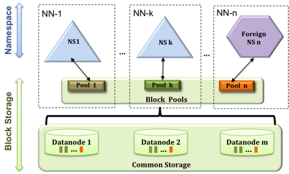
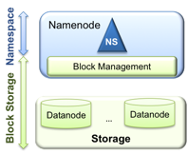
HDFS Federation
Classical HDFS
Federated HDFS
Newer HDFS versions support federation
  Multiple independent Namenodes share a common storage
  Each Namenode has a separate block pool, so it can generate block IDs without coordinating w/other Namenodes
University of Pennsylvania

Slide 31
Plan for today
A brief history of Hadoop
Writing jobs for Hadoop
  Mappers, reducers, drivers
  Compiling and running a job
Hadoop Distributed File System (HDFS)
  Node types; read and write operation
  Accessing data in HDFS
Hadoop internals
  Dataflow: Input format, partitioner, combiner, ...
  Fully distributed mode: Node types, setup
  Fault tolerance; speculative execution
NEXT
University of Pennsylvania

Slide 32
Accessing data in HDFS
[ahae@carbon ~]$ ls -la /tmp/hadoop-ahae/dfs/data/current/
total 209588
drwxrwxr-x 2 ahae ahae 4096 2015-10-06 15:46 .
drwxrwxr-x 5 ahae ahae 4096 2015-10-06 15:39 ..
-rw-rw-r-- 1 ahae ahae 11568995 2015-10-06 15:44 blk_-3562426239750716067
-rw-rw-r-- 1 ahae ahae 90391 2015-10-06 15:44 blk_-3562426239750716067_1020.meta
-rw-rw-r-- 1 ahae ahae 4 2015-10-06 15:40 blk_5467088600876920840
-rw-rw-r-- 1 ahae ahae 11 2015-10-06 15:40 blk_5467088600876920840_1019.meta
-rw-rw-r-- 1 ahae ahae 67108864 2015-10-06 15:44 blk_7080460240917416109
-rw-rw-r-- 1 ahae ahae 524295 2015-10-06 15:44 blk_7080460240917416109_1020.meta
-rw-rw-r-- 1 ahae ahae 67108864 2015-10-06 15:44 blk_-8388309644856805769
-rw-rw-r-- 1 ahae ahae 524295 2015-10-06 15:44 blk_-8388309644856805769_1020.meta
-rw-rw-r-- 1 ahae ahae 67108864 2015-10-06 15:44 blk_-9220415087134372383
-rw-rw-r-- 1 ahae ahae 524295 2015-10-06 15:44 blk_-9220415087134372383_1020.meta
-rw-rw-r-- 1 ahae ahae 158 2015-10-06 15:40 VERSION
[ahae@carbon ~]$
HDFS implements a separate namespace
  Files in HDFS are not visible in the normal file system
  Only the blocks and the block metadata are visible
  HDFS cannot be (easily) mounted
    Some FUSE drivers have been implemented for it (and a NFS proxy)
University of Pennsylvania

Slide 33
Accessing data in HDFS
[ahae@carbon ~]$ /usr/local/hadoop/bin/hadoop fs -ls /user/ahae
Found 4 items
-rw-r--r-- 1 ahae supergroup 1366 2015-10-06 15:46 /user/ahae/README.txt
-rw-r--r-- 1 ahae supergroup 0 2015-10-06 15:35 /user/ahae/input
-rw-r--r-- 1 ahae supergroup 0 2015-10-06 15:39 /user/ahae/input2
-rw-r--r-- 1 ahae supergroup 212895587 2015-10-06 15:44 /user/ahae/input3
[ahae@carbon ~]$
File access is through the hadoop command
Examples:
  hadoop fs -put [file] [hdfsPath] Stores a file in HDFS
  hadoop fs -ls [hdfsPath] List a directory
  hadoop fs -get [hdfsPath] [file] Retrieves a file from HDFS
  hadoop fs -rm [hdfsPath] Deletes a file in HDFS
  hadoop fs -mkdir [hdfsPath] Makes a directory in HDFS
University of Pennsylvania

Slide 34
Alternatives to the command line
Getting data in and out of HDFS through the command-line interface is a bit cumbersome
Alternatives have been developed:
  FUSE file system: Allows HDFS to be mounted under Unix
  NFS proxy: Makes HDFS look like a file server
  WebDAV share: Can be mounted as filesystem on many OSes
  HTTP: Read access through namenode's embedded web svr
  FTP: Standard FTP interface
  ...
University of Pennsylvania

Slide 35
Accessing HDFS directly from Java
Programs can read/write HDFS files directly
  Not needed in MapReduce; I/O is handled by the framework
Files are represented as URIs
  Example: hdfs://localhost/user/ahae/example.txt
Access is via the FileSystem API
  To get access to the file: FileSystem.get()
  For reading, call open() -- returns InputStream
  For writing, call create() -- returns OutputStream
University of Pennsylvania

Slide 36
What about permissions?
Since 0.16.1, Hadoop has rudimentary support for POSIX-style permissions
  rwx for users, groups, 'other' -- just like in Unix
  'hadoop fs' has support for chmod, chgrp, chown
But: POSIX model is not a very good fit
  Many combinations are meaningless: Files cannot be executed, and existing files cannot really be written to
Permissions were not really enforced
  Hadoop does not verify whether user's identity is genuine
  Useful more to prevent accidental data corruption or casual misuse of information
University of Pennsylvania

Slide 37
Where are things today?
Since v.20.20x, Hadoop has some security
  Kerberos RPC (SASL/GSSAPI)
  HTTP SPNEGO authentication for web consoles
  HDFS file permissions actually enforced
  Various kinds of delegation tokens
  Network encryption
  For more details, see:
  https://issues.apache.org/jira/secure/attachment/12428537/security-design.pdf
Big changes are coming
  Project Rhino (e.g., encrypted data at rest)
University of Pennsylvania

Slide 38
Recap: HDFS
HDFS: A specialized distributed file system
  Good for large amounts of data, sequential reads
  Bad for lots of small files, random access, non-append writes
Architecture: Blocks, namenode, datanodes
  File data is broken into large blocks (64MB default)
  Blocks are stored & replicated by datanodes
  Single namenode manages all the metadata
  Secondary namenode: Housekeeping & (some) redundancy
Usage: Special command-line interface
  Example: hadoop fs -ls /path/in/hdfs
More details: Chapter 3 of your textbook
University of Pennsylvania

Slide 39
Plan for today
A brief history of Hadoop
Writing jobs for Hadoop
  Mappers, reducers, drivers
  Compiling and running a job
Hadoop Distributed File System (HDFS)
  Node types; read and write operation
  Accessing data in HDFS
Hadoop internals
  Dataflow: Input format, partitioner, combiner, ...
  Fully distributed mode: Node types, setup
  Fault tolerance; speculative execution
NEXT
University of Pennsylvania

Slide 40
Recap: High-level dataflow
Intermediate
(key,value) pairs
Mapper
Reducer
Mapper
Reducer
Input data
Output data
Mapper
Reducer
Mapper
Reducer
"The Shuffle"
University of Pennsylvania

Slide 41
Detailed dataflow in Hadoop
Node 1
Node 2
InputFormat
InputFormat
File
File
File
File
Split
Split
Split
Split
Split
Split
Local HDFS
store
Local HDFS
store
RR
RR
RR
RR
RR
RR
map
map
map
map
map
map
Combine
Combine
Partition
Partition
Sort
Sort
Reduce
Reduce
OutputFormat
OutputFormat
University of Pennsylvania

Slide 42
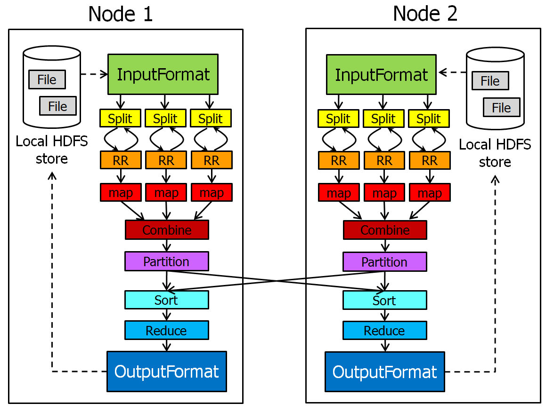
Input Format
Defines which input files
should be read, and how
  Defaults provided, e.g., TextInputFormat,
  DBInputFormat, KeyValueTextInputFormat...
Defines InputSplits
  InputSplits break file into separate tasks
  Example: one task for each 64MB block (why?)
Provides a factory for RecordReaders
  RecordReaders actually read the file into (key,value) pairs
  Default format, TextInputFormat, uses byte offset in file as the key, and line as the value
  KeyValueInputFormat reads (key,value) pairs from the file directly; key is everything up to the first tab character
University of Pennsylvania

Slide 43
Combiners
Optional component that can
be inserted after the mappers
  Input: All data emitted by the mappers
  on a given node
  Output passed to the partitioner
Why is this useful?
  Suppose your mapper counts words by emitting (xyz, 1) pairs for each word xyz it finds
  If a word occurs many times, it is much more efficient to pass (xyz, k) to the reducer, than passing k copies of (xyz,1)
University of Pennsylvania

Slide 44
Partitioner
Controls which intermediate
key-value pairs should go
to which reducer
Defines a partition on the set of KV pairs
  Number of partitions is the same as the number of reducers
Default partitioner (HashPartitioner) assigns partition based on a hash of the key
University of Pennsylvania

Slide 45
Output Format
Counterpart to InputFormat
Controls where output is
stored, and how
  Provides a factory for RecordWriter
Several implementations provided
  TextOutputFormat (default)
  DBOutputFormat
  MultipleTextOutputFormat
  ...
University of Pennsylvania

Slide 46
Recap: Dataflow in Hadoop
Hadoop has many components that are usually hidden from the developer
Many of these can be customized:
  InputFormat: Defines how input files are read
  InputSplit: Defines how data portions are assigned to tasks
  RecordReader: Reads actual KV pairs from input files
  Combiner: Mini-reduce step on each node, for efficiency
  Partitioner: Assigns intermediate KV pairs to reducers
  Comparator: Controls how KV pairs are sorted after shuffle
More details: Chapter 8 of your textbook
University of Pennsylvania

Slide 47
Plan for today
A brief history of Hadoop
Writing jobs for Hadoop
  Mappers, reducers, drivers
  Compiling and running a job
Hadoop Distributed File System (HDFS)
  Node types; read and write operation
  Accessing data in HDFS
Hadoop internals
  Dataflow: Input format, partitioner, combiner, ...
  Fully distributed mode: Node types, setup
  Fault tolerance; speculative execution
NEXT
University of Pennsylvania

Slide 48
Hadoop daemons (pre-YARN)
TaskTracker
  Runs maps and reduces. One per node.
JobTracker
  Accepts jobs; assigns tasks to TaskTrackers
DataNode
  Stores HDFS blocks
NameNode
  Stores HDFS metadata
SecondaryNameNode
  Merges edits file with snapshot; "backup" for NameNode
A single node can run
more than one of these!
University of Pennsylvania

Slide 49
An example configuration
JobTracker
NameNode
Secondary
NameNode
Small cluster
Medium cluster
JobTracker
NameNode
Secondary NameNode
TaskTracker
DataNode
University of Pennsylvania

Slide 50
Fault tolerance
What if a node fails during a job?
  JobTracker notices that the node's TaskTracker no longer responds; re-executes the failed node's tasks
What specifically should be re-executed?
  Depends on the phase the job was in
  Mapping phase: Re-execute all maps assigned to failed node
  Reduce phase: Re-execute all reduces assigned to the node
    Is this sufficient?
    No! Failed node may also have completed map tasks, and other nodes may not have finished copying out the results
    Need to re-execute map tasks on the failed node as well!
University of Pennsylvania

Slide 51
Speculative execution
What if some tasks are much harder, or some nodes much slower, than the others?
  Entire job is delayed!
Solution: Speculative execution
  If task is almost complete, schedule a few redundant rasks on nodes that have nothing else to do
  Whichever one finishes first becomes the definitive copy; the others' results are discarded to prevent duplicates
University of Pennsylvania

Slide 52
Placement and locality
Block
replicas
Task
Rack 1
Rack 2
Rack 1
Rack 2
Datacenter A
Datacenter B
Which of the replicated blocks should be read?
  If possible, pick the closest one (reduces network load)
  Distance metric takes into account: Nodes, racks, datacenters
Where should the replicas be put?
  Tradeoff between fault tolerance and locality/performance
University of Pennsylvania

Slide 53
Changes in Hadoop 2.0
In Hadoop 2.0/YARK, the two major responsi-bilities of the JobTracker have been split
  Applications run in per-node containers
  Global ResourceManager
    Arbitrates resources among all the applications in the system based on their requirements (memory, CPU, ...)
    A 'pure' scheduler. Scheduling algorithms are pluggable.
  Per-application ApplicationMaster
    Negotiates resources from the RM
    Works with the NMs to execute/monitor the tasks
    Responsible for status/progress tracking, fault tolerance, etc.
  Per-node NodeManager
    Launches the containers, monitors resource consumption
    Reports to the ResourceManager
  Backwards-compatible to existing MapReduce applications
University of Pennsylvania

Slide 54
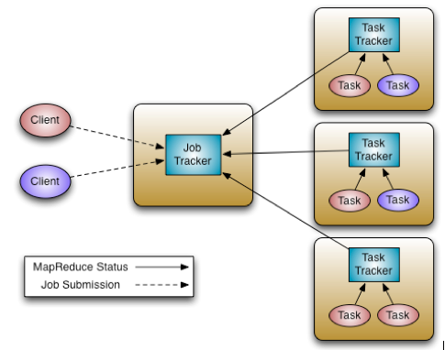
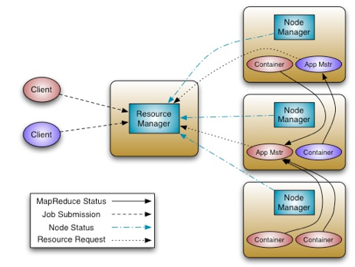
YARN architecture
Hadoop 1.0
Hadoop 2.0/YARN
Pros and cons of this architecture?
  Better scalability (one Application Master per application)
  Can support other frameworks (MPI, graph processing, ...)
University of Pennsylvania

Slide 55
Recap: Distributed mode
Five important daemons:
  MapReduce daemons: JobTracker, TaskTracker
  HDFS daemons: DataNode, NameNode, Secondary NameN.
  Workers run TaskTracker+DataNode
Special features:
  Transparently re-executes jobs if nodes fail
  Speculatively executes jobs to limit impact of stragglers
  Rack-aware placement to keep traffic local
More details: Chapter 10 of your textbook
University of Pennsylvania

Slide 56

Stay tuned
Next time you will learn about:
Iterative MapReduce
University of Pennsylvania

